Slide 1
ROCKET DRAG
LabRat Scientific
© 2018

Slide 2
What is Drag ?
Drag includes a “pressure” force and a “frictional” force
High pressure when acting on the front of a moving object
Low pressure (suction) at the back of a moving object
Friction along the body of the object
Friction
Low Pressure
Direction of Motion
High Pressure
High pressure pushes on the front of the rocket – tends to slow the rocket down.
Low pressure on the back of the rocket tries to suck the rocket backwards – tends to slow the rocket down.
Drag always acts to slow down the rocket

Slide 3
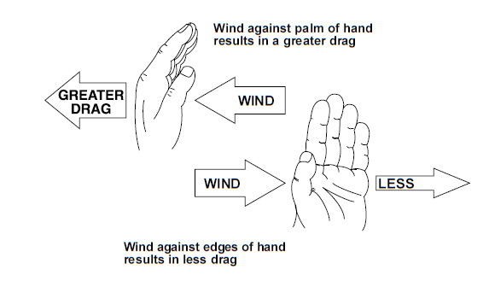
Getting a “Feel” for Drag

Slide 4
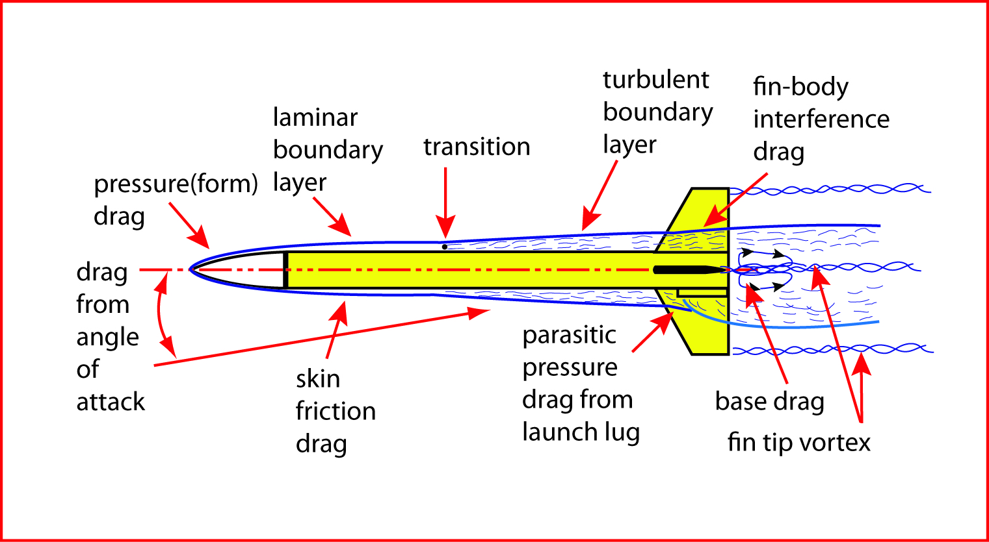
The rocket disturbs the air as it moves through it. This disturbance is “drag”…

Slide 5
The Drag Equation
Drag = ½ x Air Density x Velocity² x CD x Reference Area
Air Density decreases as altitude increases (it’s variable…).
Velocity tends to be variable also. Drag is a function of the “square” of the velocity.
The Drag Coefficient (CD) is the “shape factor” that characterizes the drag nature of the object.
The reference area (usually the “body tube” area when viewed from the end) allows the drag to be scaled relative to the size of the object.

Slide 6
The Impact of Drag…
Recall the expanded version of Newton’s Second Law of Motion…
Thrust - Drag - Weight
Accel = --------------------------------------
Mass
Acceleration becomes smaller (and maybe negative) as drag becomes larger
A lower acceleration translates into a lower velocity… Integrate a smaller acceleration and you get a smaller velocity…
A lower velocity means the rocket will not fly as high

Slide 7
Increased Rocket Performance through Drag Reduction

Slide 8
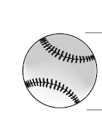
Reduce High Pressure on Front by adding a Nose Cone
High Pressure
Low Pressure
Direction of Motion
Low Pressure
Less High Pressure
Direction of Motion

Slide 9
Nose Drag
A blunt nose will create a higher pressure force, and will cause the flow to separate at the forward end of the body tube, which creates more drag.
Better Configuration
While the long nose cone will have more surface area and thus more skin friction drag, the flow is much smoother around the front of the rocket, which reduces drag overall.

Slide 10
Reduce Low Pressure on Aft End by adding a Boat Tail
High Pressure
Low Pressure
Large Area
Direction of Motion
Recall:
Pressure x Area = Force
High Pressure
Low Pressure
Smaller Area
Direction of Motion

Slide 11
Base Drag
The wide base of this rocket causes flow separation and high pressure drag at the back of the rocket.
Better Configuration
Tapering the back of the rocket allows the flow to curve around more easily and reduces the size of the low pressure area behind the rocket. The tapered section is know as a “boat tail”, and they can be a little tricky to construct…

Slide 12
Base Drag - Coasting
Even with a boat tail, there is going to be base drag on the body tube.

Slide 13
Base Drag - Thrusting
The rocket’s drag is lower during motor burn since the rocket motor exhaust “reduces” the low pressure at the base of the rocket. Its sort of a perfect boat tail…

Slide 14
Fin Drag
Better Configuration
Fins suffer the same issues as the rocket body – high pressure at the front, low pressure at the back, and friction
Fins need to have curved leading and trailing edges to reduce the total pressure drag.
The number of fins must be minimized as well. 3 or 4 fins are adequate to provide the necessary stability. More fins are just unnecessary drag producers…

Slide 15
Make Your Rocket Smooth and Streamlined
Fins that are too large and not sanded smooth
Launch lug that is too big
Poor paint job with bubbles and runs
Higher total drag
Better Configuration
Make fins only as large as they need to be for stability. Sand fins smooth and maybe sand “fuzz” off the body tube. Cover the rocket with a even coat of paint to give a smooth, slick finish.

Slide 16
Smooth Surface = More Laminar Flow = Less Drag
Rough Rocket Skin
Smooth Rocket Skin = Less Drag
A turbulent flow interacts with the rocket skin more and thus creates more drag. Drag is reduced if the flow can be kept smooth…

Slide 17
Reduce Interference Drag
Add Fillets to Make a Smooth Transition from Fin to Body Tube
The flow around the fins “interferes” with the flow along the body – and visa versa
White glue can be used, but you can only effectively build up one fillet at a time…

Slide 18
Calculation
of
Theoretical Model Rocket Drag

Slide 19
The Drag Equation
Recall the basic equation for calculating the drag force acting on the rocket:
Drag = ½ x Air Density x Velocity² x CD x Reference Area
The trick is to be able to estimate the drag coefficient (CD) of the rocket…

Slide 20
Total Drag Coefficient
Cd_{Total}
= Cd_{SF}
+ Cd_{B}
+ Cd_{L}
+ Cd_{I}
Cd_{SF} = Skin Friction Drag Coefficient
Cd_{B} = Base Drag Coefficient
Cd_{L} = Launch Lug Drag Coefficient
Cd_{I} = Interference Drag Coefficient
The Total Drag Coefficient is derived by taking the sum of CD’s calculated for the various major elements of the rocket.
If you design a rocket with all kinds of “stuff” handing off it, you will need to calculate the “stuff” drag coefficient. That can become very difficult.

Slide 21
Determining the drag coefficient of a rocket is not a trivial task. There are a lot of equations and assumptions involved.
What a drag…

Slide 22
The equations we are about to examine (or be confused by) were not conjured out of thin air, they were derived from countless wind tunnel tests during the 1930’s, 40’s and 50’s…
Somehow, smart people in the past devised mathematical equations that approximated the data that was collected in wind tunnels…

Slide 23
Some Basic Rocket Geometry
L
d
A_{BT}
S _{wet, body} = Pi * Body Diameter * Length (approx. since nose is not a cylinder)
S _{wet, fins} = Fin Area * No. fins * 2
A_{BT} = Pi x (Body Radius)²
Tip Chord
a
a + b + c
Chord _{Ave} = ------------
3
d
Root Chord
c
A_{BT}

Slide 24
Skin Friction Coefficient
Before we can estimate all the various CD values, we need to calculate one critical factor – The Skin Friction Coefficient…
This is the most difficult parameter to estimate. There are 3 equations that can be used, and the appropriate equation to be used depends on how the airflow is moving around the rocket.
The Skin Friction Coefficient depends on whether the airflow passing over the rocket skin is nice and smooth (laminar) or all mixed up (turbulent). The type of airflow is governed by the Reynolds Number (Re).
Before we get to Re, lets look at the equations…

Slide 25
Critical Reynolds Number
- 1.039
Surface Roughness Height
Re_{critical} = 51 * ----------------------------------------
Rocket Length
Surface | Roughness Height (in) | Roughness Height (m)
Rough Finish | 0.76 | 0.0197
Unfinished Surface | 0.23 | 0.0059
Regular Paint Finish | 0.094 | 0.0024
Smooth Paint Finish | 0.031 | 0.00079
The critical Reynolds Number gives us an idea where along the rocket the flow will trip from laminar (smooth) and turbulent (all mixed up). The closer to the nose the tripping point, the higher the drag…

Slide 26
Reynolds Number
Density * Velocity * Rocket Length
Re = -----------------------------------------------------
Absolute Viscosity
ASSUMPTIONS:
Air Absolute Viscosity = 0.000012024 lb/(ft*sec)
Air Density = 0.076314 lb/ft3
Rocket Length = 3 ft
Velocity = 150 Ft/sec
Reynolds Number is unitless with a magnitude in the low millions…

Slide 27
Skin Friction Coefficient
We look at the rockets Reynolds Number relative to the rocket’s critical Reynolds number to determine what equation to use.
If Re < 100,000 C_{f} = 1.48 x 10 ⁻²
1
If 100,000 < Re < Re _{critical} C_{f} = ----------------------------
((1.5 * ln Re) - 5.6) ²
Rs ^{0.2}
If Re > Re _{critical} C_{f} = 0.032 * -------- L
L = Length of rocket
Rs = Surface Roughness Height (make a guess based on the surface
of your rocket and the previous table)
ln = natural log

Slide 28
Compressibility Corrections
Subsonic C_{fc} = C_{f} * ( 1 - (0.1 x M²) )
C_{f}
Supersonic C_{fc} = C_{f} * -------------------------------
(turbulent) ( 1 + (0.15 x M²) ) ^{0.58}
The drag changes drastically when the flow becomes supersonic. This should be accounted for in “real rocket science”, but for typical model rockets that fly below the speed of sound, it’s not a real concern…

Slide 29
Body & Fin Skin Friction Drag Coefficient
1 2 * t
(1 + ------- ) * S _{wet, body} + (1 + ------ ) * S _{wet, fins}
2 * fb c
Cd_{F} = C_{fc} * -----------------------------------------------------------------
A _{BT}
S _{wet, body} = Wetted surface area of body tube
S _{wet, fins} = Wetted area of all fins, both sides (Fin Area x No. fins x 2)
A _{BT} = Body tube reference area (area of the body tube when viewed from the end)
c = Average chord length
C_{fc} = Skin friction coefficient - corrected
fb = Fineness ratio of the rocket (rocket length / rocket diameter)
t = Fin thickness
Since this is a unitless coefficient it doesn’t matter what units are used, as long as they are consistent.

Slide 30
Base Drag Coefficient
0.029
Cd_{B} = --------------
C_{fc}
C_{fc} = skin friction coefficient - corrected

Slide 31
Interference Drag Coefficient
t C_{R}
Cd_{I} = C_{fc} * ( 1 + 2 * --------- ) * ---------- * d * n
c _{Ave} S _{wet body}
C_{R} = Fin Root Chord
c_{Ave} = Average Fin Chord
S _{wet body} = Wetted Surface Area of Body Tube and Nose Cone
C_{fc} = Skin Friction Coefficient - corrected
d = Body Diameter
n = Number of Fins
T = Fin Thickness

Slide 32
Launch Lug Drag Coefficient
1.2 A_{LL} + (0.0045 * S _{wet lug} )
Cd_{L} = --------------------------------------
S _{wet body}
A _{LL} = Cross-sectional Area of Launch Lug
S _{wet lug} = Wetted Surface Area of Launch Lug
S _{wet body} = Wetted Surface Area of Body Tube and Nose Cone

Slide 33
Cd From a Wind Tunnel Test
While a Cd of 0.75 is a reasonable value to use in a simple model rocket simulation, you could put your rocket into a wind tunnel and measure the drag force acting on it.
You can assume a “standard day” where the air density is 0.00237 slug/ft3. You will also need to accurately measure the velocity of the airflow in the tunnel. The reference area is the area of the body tube when viewed from the end. Once you have measured the drag you have everything you need to calculate the drag coefficient. This is done using the drag equation:
Drag = ½ x Air Density x Velocity² x Cd x Reference Area

Slide 34
Cd From a Wind Tunnel Test
We apply some algebra to the drag equation to come up with an equation that allows us to calculate the Cd.
2 x Drag
Cd = ------------------------------------------------------------
Air Density x Velocity² x Reference Area
If you are building a big rocket, you can make a smaller model to place in the wind tunnel – as long as it has the same shape and proportions. Calculate the Cd of the model using the reference area of the model. Then, when calculating the drag on the actual rocket, use the full scale rocket’s reference area. This “reference area” allows you to scale the drag…

Slide 35
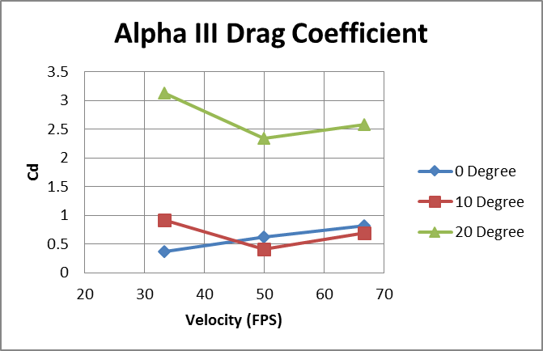

Slide 36
Questions ?

